Slide 1
University Health Partners

Slide 2

Overview of University Health Partners
Medical Services
Office of Health Advancement
Counseling and Psychological Services
Dental Services

Slide 3
Medical Services
Primary Health Care For MSU Students
  Appointments
  Walk-ins
Other Services: Lab, X-ray, Nutrition, Health Advancement, Allergy Shots, Travel Clinic
Pharmacy

Slide 4
Dental Services
Preventative
  Routine dental hygiene check-ups and cleanings
Urgent Care
Restorative Care
  Fillings, crowns, etc.

Slide 5
Hours
Medical Services Regular Academic Semesters
  8:00 a.m. to 4:30 p.m. (Mon-Fri)
  8:00 a.m. to 11:30 a.m. (Sat) – Appointment Only
Dental Services Regular Academic Semesters
  8:00 a.m. to 4:30 p.m. (Mon-Fri)
Office of Health Advancement
  8:00am-4:30pm ( Mon-Fri)
  Wellness Coaching by appointment
  Dietitian by appointment
  Licensed Substance Abuse Counselor by appointment
Counseling & Psychological Services
  8:00 a.m to 5:00 p.m. (Mon-Fri)
  Some evening hours by appt.

Slide 6
Services Provided Elsewhere
After Hours (connected to nurse advice line if main number called after hours)
  Urgent Care
  ER at Bozeman Deaconess Hospital
Overnight/hospitalization
Specialists
Complex Diagnostic Testing (MRI’s, etc.)

Slide 7
Costs
Mandatory Health Fee (all students taking 7 credits or more)
No charge for visits to see a medical or counseling provider
Dental is subsidized by the health fee; charges are about half the community rates
Co-pay for lab, x-ray, dental
Pharmacy—Charge for drug plus direct costs
Wellness Coaching – Free
Dietitian – Free for students taking 7 credits or more
Alcohol and Drug Assistance Center – Free

Slide 8
Payment
Payment expected when service rendered
Accept cash, checks, Master Card, Visa, Discover, MSU’s Cat Card
Don’t bill insurance (exception: MSU sponsored insurance plan and most pharmacy plans)
Students will receive receipt they can use to file claims

Slide 9
Important Points
Quality Assurance (Accredited by AAAHC)
Counseling Service accredited by IACS
Confidentiality (students are considered adults; consent required to release information)

Slide 10
Immunizations
Required to Register for Classes
  2 MMR’s
  Tuberculosis Screen
Recommended
  Tetanus/Diphtheria/Pertussis Booster
  Hepatitis B Series
  Meningitis
  Chicken Pox
  Flu
  HPV

Slide 11
Insurance
Some form of insurance required (needed to cover hospitalization, specialists, ER)
All students taking 6 or more credits are automatically charged the premium unless waived
Waiving occurs on-line when student registers for classes
UHP serves all students regardless of ins. source

Slide 12
Important Features
Montana University System Student Insurance Plan (MUSSIP)
  Low office visit co-pays and deductible
  National Blue Cross/Blue Shield provider network (including Bozeman, of course)
  Coverage when students travel internationally
  Complies with all requirements of the Affordable Care Act including no pre-existing condition exclusions and no lifetime dollar limits

Slide 13
Why Consider MUSSIP?
  Lower cost than keeping a dependent student on a parents plan
  Lower deductible than many employer plans
  Lower cost than comparable plans offered on the state insurance marketplaces
  Provider network in Bozeman as well as nationally plus international coverage

Slide 14
Insurance—Important Points
If covered by managed care plan in another state, check on coverage in Bozeman
Be sure student has copy of insurance ID card
Insurance questions?
Contact: Robin Kuntzelman
406.994.3199
robink@montana.edu

Slide 15

QUESTIONS?

Slide 16
Office of Health Advancement
Educate, Empower & Energize
the MSU Community to thrive through a balanced lifestyle
Environmental approach to health and well-being. Primary prevention and risk reduction.
Alcohol EDU, Sexual Assault Prevention,
and Transit
  Mandatory education prior to Fall semester
  COURSES OPEN AUGUST 1ST
Tobacco Free MSU
  Cessation resources

Slide 17

Office of Health Advancement
Dietitian – (406) 994-4380
  Free to students that pay health fee
Wellness Coaching - FREE
  One on One coaching, Group coaching
Insight Alcohol and Drug Assistance
  406-994-5937
Center for Students in Recovery
Travel Medicine
VOICE center – (406) 994-7069
  24 hour confidential support

Slide 18

Office of Health Advancement
Programs with Residence Life and other units on campus
Events, Programs, outreach for prevention and education
  FaceBook, Youtube videos, other social media outlets for nutrition ideas and how to eat healthy in your residence hall
  Catapalooza
  Body Project workshops/Body Acceptance Club
  Night at the Museum ( Halloween weekend)
  De-stress fest during exam weeks

Slide 19
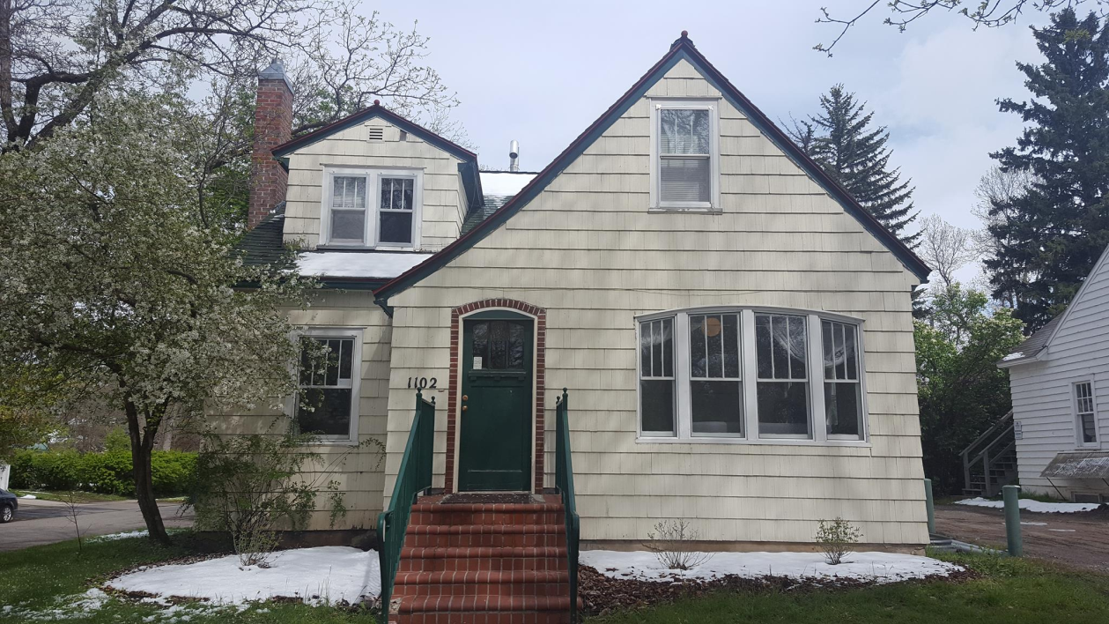

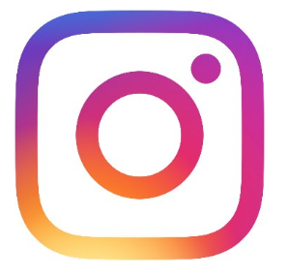

QUESTIONS?
MSU OFFICE OF HEALTH ADVANCEMENT
www.montana.edu/oha/
1102 South 6th Street
(406) 994-4380

Slide 20

Mental Health Services at MSU

Slide 21
National Picture-US College Student Data
Sometime within the last year:
  89% reported lack of sleep disrupted functioning
  58% reported overwhelming anxiety
  36% reported significant depression
  9% reported having seriously considered suicide
  American College Health Association
  National College Health Assessment, Spring 2016

Slide 22
Importance of Treatment
Mental Health Issues are Medical Conditions
  Early diagnosis/treatment improves outcome
  Treatment helps
Developmental Issues
  Skills training
  Improved understanding
  Behavior change
  Increased motivation

Slide 23

Counseling and Psychological Services (CPS)
Free & Confidential Counseling
18 Licensed mental health clinicians
5 Professional Residents
Swingle Hall, above Medical Services
www.montana.edu/counseling
www.montana.edu/suicide-prevention

Slide 24
CPS Data AY 2017-18
Total Clients: 1705
Top Presenting Concerns:
  Depression
  Anxiety
  Adjustment Issues
  Abuse/Trauma
  Relationship Issues (parents & partners)
  Alcohol & Substance Use
Previous Counseling: 52%
Psychotropic Medication: 29%
Suicidal Ideation: 39%

Slide 25
CPS Services
Individual Counseling
  Broad range
  Mental Health Disorders and Developmental Issues
  Generally short-term agency
Group Counseling
  Interpersonal Skills/Support
  Stress Management/Relaxation
  Social Skills
  Vary each semester by need/interest
Couples Counseling
Crisis Intervention/Management
  Assess risk
  Safety plan
  Collaborate with Res Life, Campus Police, Dean of Students, others
  Provide services/referral for additional assessment/treatment
Referral
  Medical Services: physical; medication consultation
  Off-campus services

Slide 26
Evaluation Data
98% Satisfied with their counseling experience
94% Felt counseling helped resolve concerns
82% Counseling helped stay in school
99% Would refer a friend
100% Important for MSU to offer counseling services
Functioning Effectively
  Before Counseling: 31%
  After Counseling: 82%

Slide 27
Questions To Ask Your Student
How have you been sleeping?
How are you managing stress?
What’s going well? What do you wish were going better?
How are you adjusting? (ask for examples of “fine”)
What do you do to relax? What helps you de-stress?
What’s caused the most worry/difficulty so far?
What’s been different than high school?
Have you reached out for any resources on campus? For yourself or a friend?
Have you felt depressed or anxious?

Slide 28
Potential Signs of Suicide
Verbal Clues
  Talk of suicide, not being around, “better off dead”
  Hopelessness, worthlessness, being a burden
Behavioral Clues
  Sudden changes
  Depression, moodiness, withdrawal
  Putting affairs in order; short-sighted about problems/future
Situational Stressors
  Loss/Failure (real and perceived)
  Shame; Legal/academic issues

Slide 29
Ask About Suicide
Have you had any suicidal thoughts?
Have things been so bad you’ve thought about suicide?
When people feel hopeless they often have thoughts of suicide, I wonder if you do, too.
Asking directly opens discussion and leads to safety/relief and referral.
If they have thoughts of suicide:
  Remove access to firearms or other means
  Get professional

Slide 30
How to Refer
I can be supportive, and it also seems like counseling may help you with _____.
I’ve noticed _____ and that is often a symptom of _____. It seems that talking with someone at CPS could be helpful.
You’ve really been working hard at _____ and things haven’t gotten better. Let’s see if some additional support at CPS could be useful.
I wonder if you might be experiencing some depression/anxiety, would you talk with someone at CPS or Medical Services to see if that could be the case?

Slide 31
Whom to Call
Campus Police (994-2121 or 911)
  If situation is imminent (life is at risk in current moment)
Dean of Students Office (994-2826)
  If student is resistant to referral/not seeking help
  For outreach/check-ins
Counseling & Psychological Services (994-4531)
  To consult about a student of concern
  To provide information in case the student is being seen at CPS

Slide 32



24-Hour Resources
Bozeman Help Center 24-Hour Helpline
  586-3333
National 800 Number
  1-800-273-8255
Crisis Text Line
  Text “MT” to 741-741
Veteran Resources

Slide 33
UHP Resources
Medical Services – (406) 994-2311
www.montana.edu/health/medical.html
Counseling and Psychological Services (406) 994-4531
www.montana.edu/counseling
www.montana.edu/suicide-prevention
Office of Health Advancement – (406) 994-4380
www.montana.edu/oha
Location of PowerPoint Slides: montana.edu/health
Look for Green Box with link

